Slide 1
Pokemon AI Battler
Algorithmic Adversaries

Slide 2
Group Members
Eric Wolff
Email: wolffec@mail.uc.edu
Phone: (513) 377-0353
Alex Turner
Email: turne2ah@mail.uc.edu
Phone: (513) 667-0154
Nick Sucietto
Email: sucietnj@mail.uc.edu
Phone: (513) 913-8178
Advisor - Prof. John Gallagher
Notes:
Everybody

Slide 3
Project Abstract
Our senior design project aims to develop an AI agent capable of playing as a Pokémon trainer using the popular online battle simulator, Pokémon Showdown’s public API. This project leverages the power of reinforcement learning techniques to create a proficient virtual trainer capable of making strategic decisions in a dynamic and competitive environment.
Pokémon Showdown is an online platform that provides a battle simulator for Pokémon games, enabling players to assemble and battle teams of Pokémon in real-time. Our project focuses on enhancing the game-playing experience by implementing a reinforcement learning algorithm to train the AI agent to make strategic decisions, such as selecting moves, switching Pokémon, and predicting the opponent's actions.
Notes:
Eric

Slide 4
User Stories
- As a developer, I want a debug mode so that I can test interactions between different elements of the game.
- As a developer, I want to determine reward/punishment criteria in a way that helps the model generalize well so that it learns the game effectively.
- As a developer, I want to figure out which AI architecture we will use so that we can create an effective machine learning model.
- As a developer, I want to be able to write scripts to query the showdown servers that we will use so that we can play locally.
- As a tester, I want to create local showdown servers so that we can test the AI and perform battles.
- As a tester, I want to test the battle mechanics on the servers so that we can ensure the AI behaves as expected.
- As a tester, I want there to be some sort of UI so that testing can be completed easier.
- As a player, I want to be able to use a variety of different teams so that the game has some longevity.
- As an AI developer, I want to have access to battle statistics to help the AI generalize.
Notes:
Nick

Slide 5
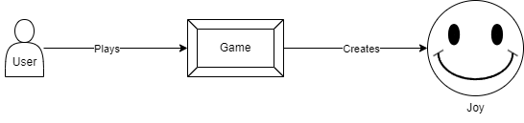
Design Diagram D0
In this diagram, the user (player), which is represented by the person icon, is playing the game to reach the goal of having a fun and unique gaming experience, which is represented by the smiley face.
Notes:
Eric

Slide 6
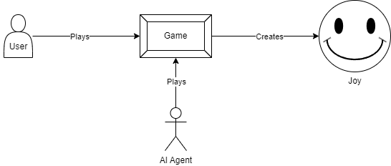
Design Diagram D1
In this diagram, the user (player), which is represented by the person icon, is playing the game. This diagram shows that the enemy in the game will be an AI agent, playing against the user. Just like the first diagram, playing this game will create a fun and unique gaming experience.
Notes:
Eric

Slide 7
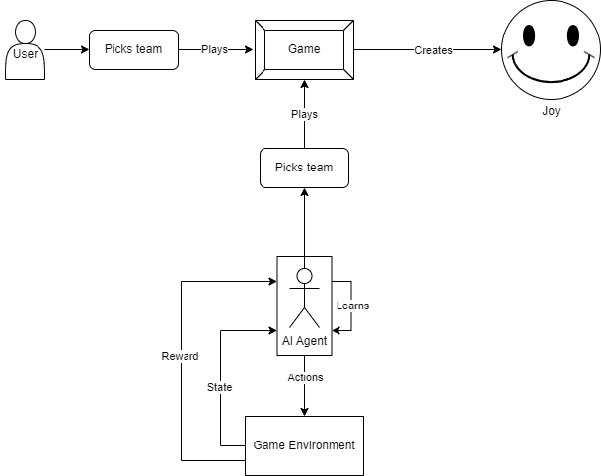
Design Diagram D2
In this diagram, the user (player), which is represented by the person icon, is picking a team of Pokemon and playing the game against the AI agent. This diagram lists more details on how the AI agent introduced in the last diagram will learn to play against the player using the game environment.
Notes:
Eric

Slide 8
Major Project Constraints
Legal
Not intruding on the Pokemon copyright
Uses public API
Server is distributed under MIT License
Social
Allow players to create and test new teams
Maintain privacy
No interaction with other human players
Environmental
Server and client must be able to connect to one another
Economic
Costs consist of computational resources and power required to continuously the AI
Notes:
Alex

Slide 9
Review of Project Progress
Server is working locally
Need to configure so it can interface with AI
AI Development has started
Game has been defined
Pre-made teams will be used for training and for testing
Selected Pokemon from Gen IV will be used
Trainer will play against itself using different team combinations
Notes:
Everybody

Slide 10
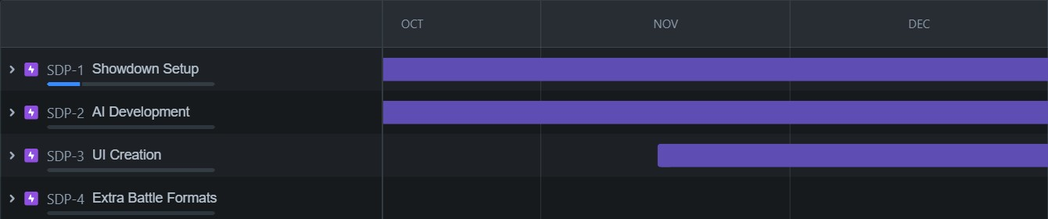
Projected Accomplishments for End of Term
Notes:
Alex

Slide 11
Division of Work
Eric - AI Development Lead
RL Environment Development
AI Research and Training
Alex - Design Lead
Game definition
Research
UI Development
Nick - Server Operations Lead
AI Server Interfacing
Server setup and maintenance
Notes:
Everybody

Slide 12
Expected Demo at Expo
Have a person play against the AI, and hopefully the AI wins
It doesn’t have to win, just have it not make dumb moves, like using an objectively bad move when there is a clearly better choice
Notes:
Nick

